Slide 1


PREDICTION OF DIABETES MELLITUS
Presented by
The Invincibles
V.Jyothi
P.Bhargavi
P.Bhavishya
P.Kamalini

Slide 2
What is diabetes?
Diabetes is a disease that occurs when your blood glucose is too high. Insulin, a hormone made by the pancreas, helps glucose from food get into your cells to be used for energy.
Types of diabetes:
1. Type 1 diabetes
2.Type 2 diabetes
3.Gestational diabetes

Slide 3
Problem Statement
Diabetes is the most dangerous disease . Most people know very little about the disease and the risks involved in it. As, prevention is better than cure , if the disease is detected at the earliest date, it can be avoided by taking the precautions.
Objective
The main objective is to make the correct prediction for a person who is effected by the disease . As a result the main emphasis is to avoid false positive case while predicting.

Slide 4
Model description
The model involves a dataset which contains:
Independent values(Factors influencing diabetes)
Dependent values(Output)
Model used : Artificial Neural Network(ANN)
Steps:
1.Preprocessing
2.Training
3.Testing
4.Deployment(By using Watson studio)
Activation Function : Sigmoid
Loss Function : binary_crossentropy
User Interface is created using Node -RED

Slide 5
How the model works?
The user interface involves a form which need to be filled with the correct information of the patient.
The information of the patient involve the following details:
1.Pregnancies
2.Glucose Level
3.Blood Pressure
4.Skin Thickness
5.Insulin Level
6.Body Mass Index(BMI)
7.Diabetes Pedigree Function
8.Age
The predicted output will be displayed to the patient which says the status of the disease that is if he/she is diabetic or not.

Slide 6
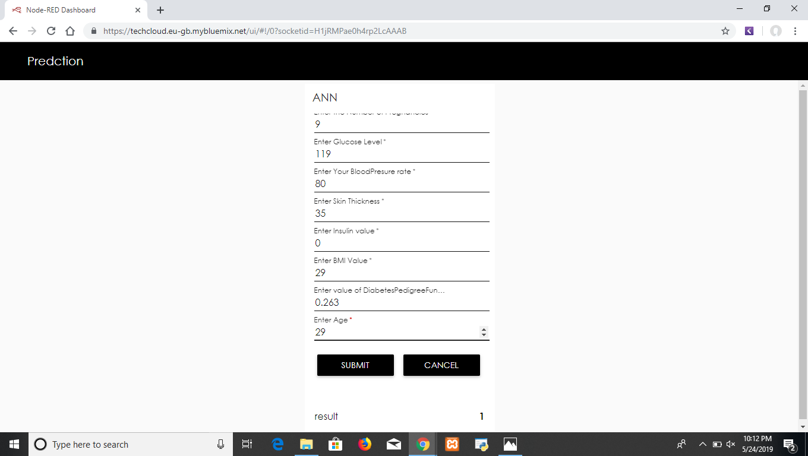
output

Slide 7
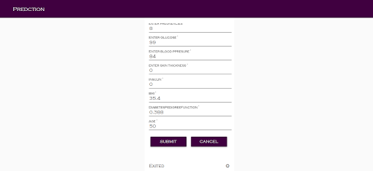

Slide 8
Conclusion
So, with the help of Artificial Neural Network(ANN) and python programming we are able to deploy the model where node red is the development tool in the IBM Cloud and are able to predict the Diabetes Mellitus in an individual with high accuracy and less false positive rate.

